Slide 1
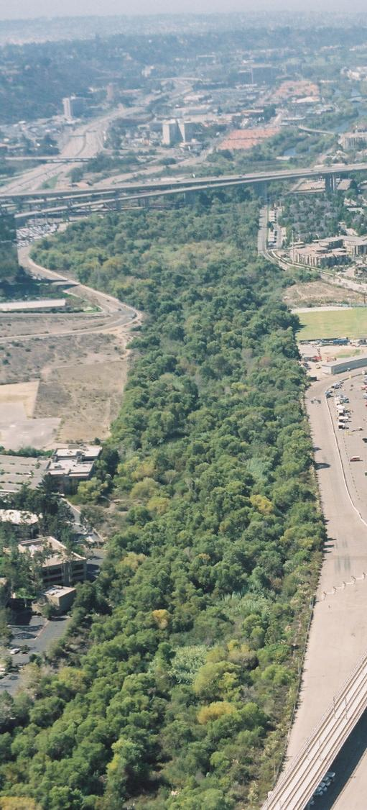
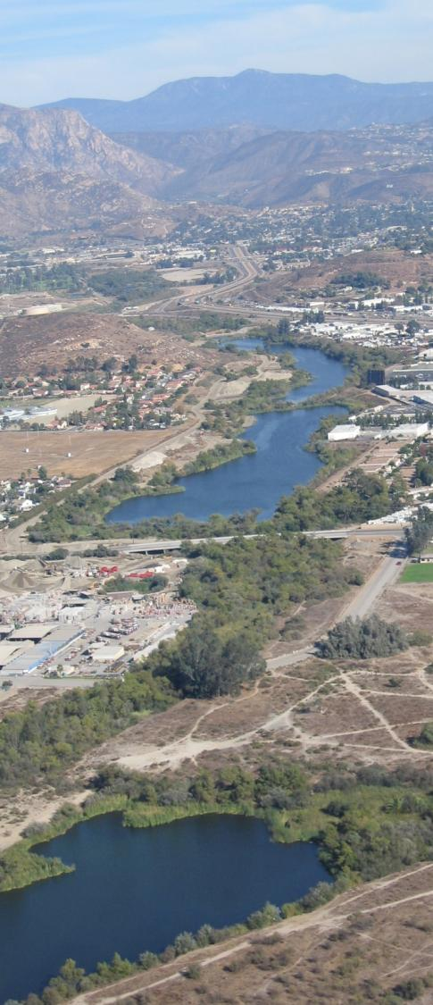
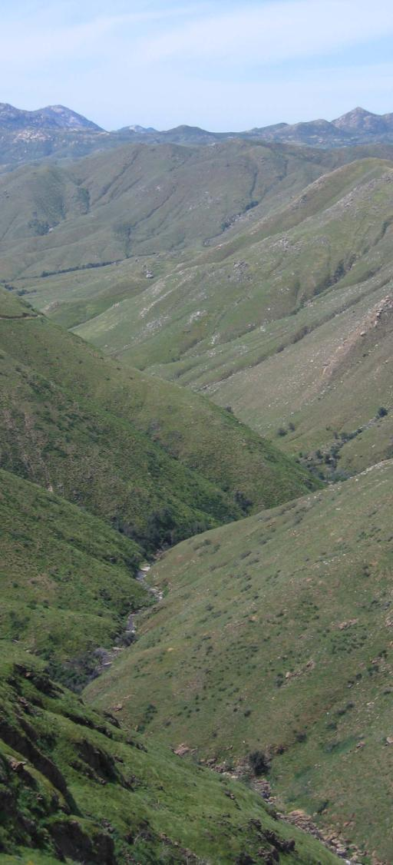
San Diego River Trail Gaps Analysis
Presented by:
Planning + Landscape Architecture
3916 Normal Street + San Diego, CA 92103 + 619 294-4477
Contact: Mark Carpenter + Project Planner + email: markc@ktua.com

Slide 2
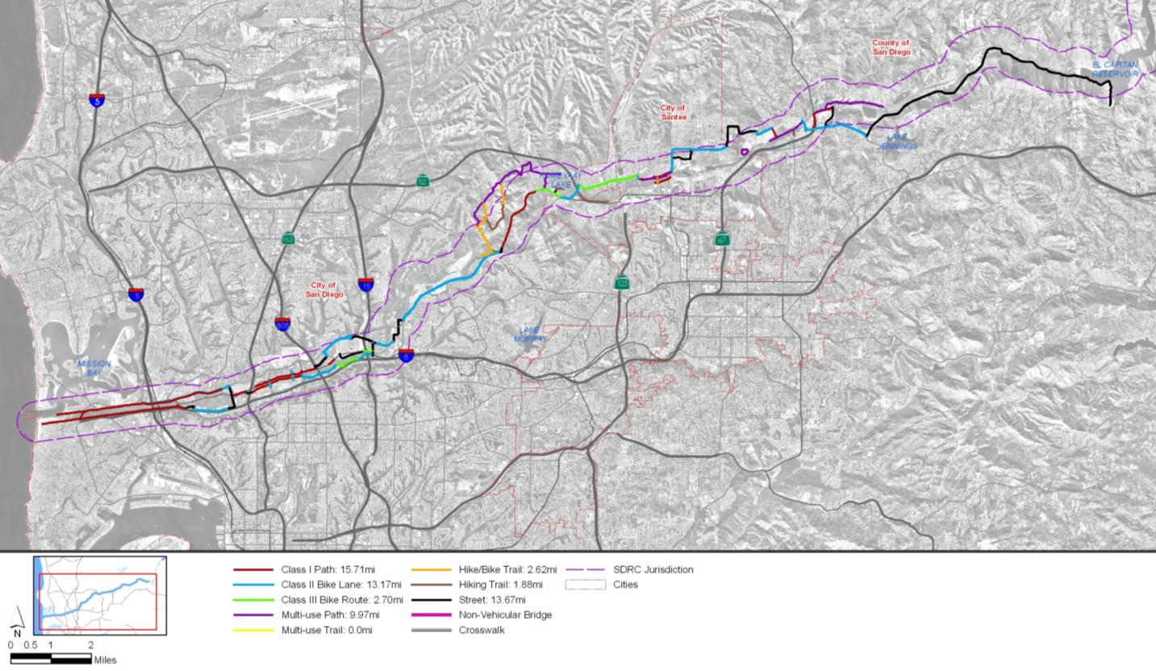
Existing Trail Facilities

Slide 3
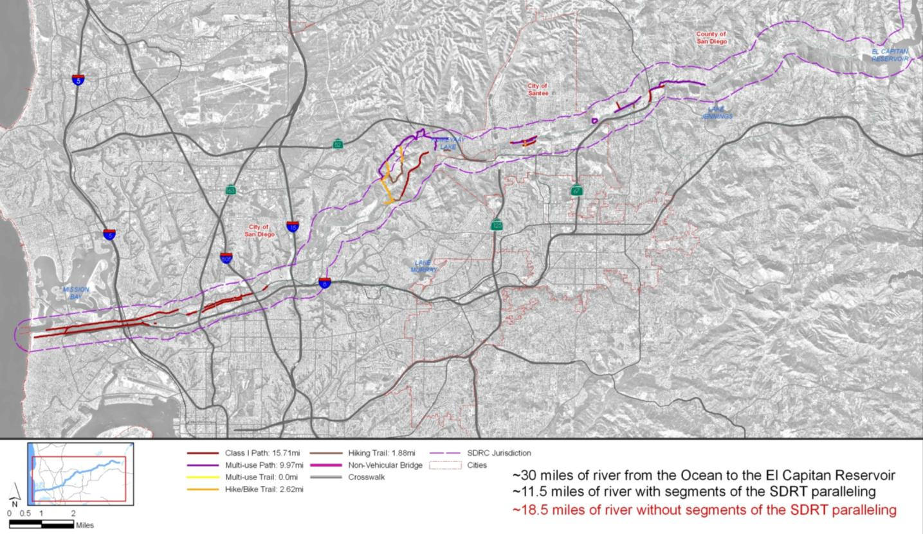
Existing Gaps

Slide 4
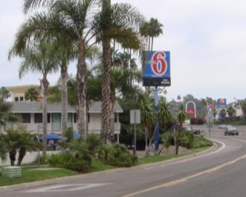
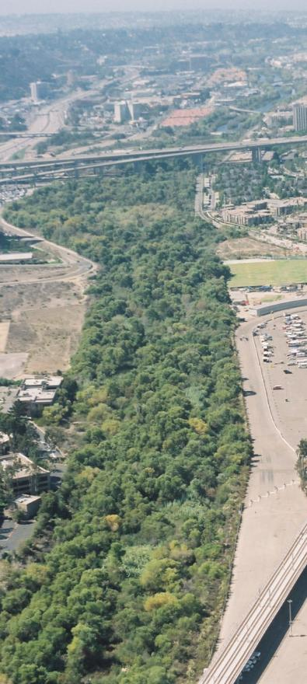
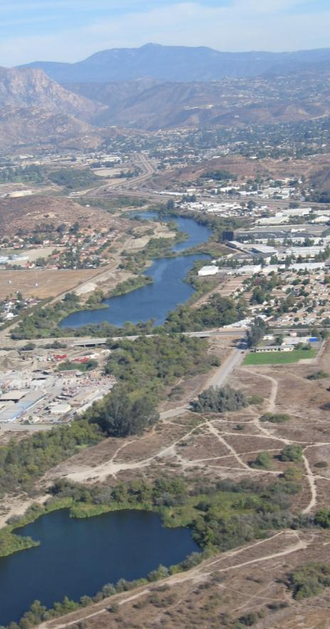
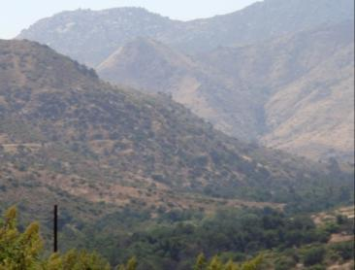
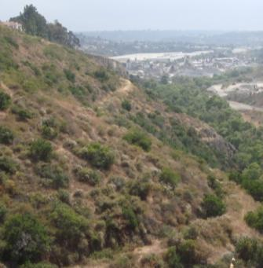
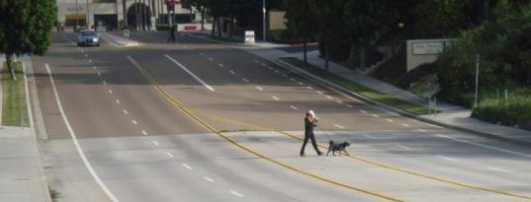
Physical Gaps

Slide 5
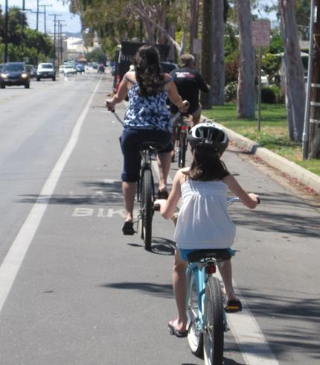
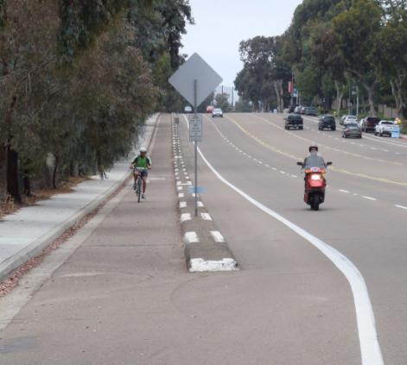
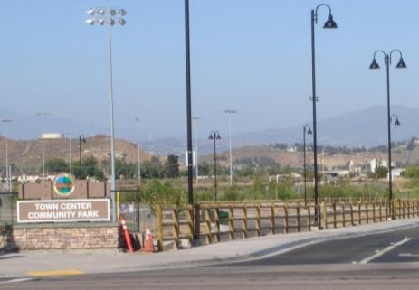
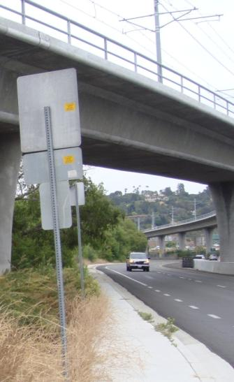
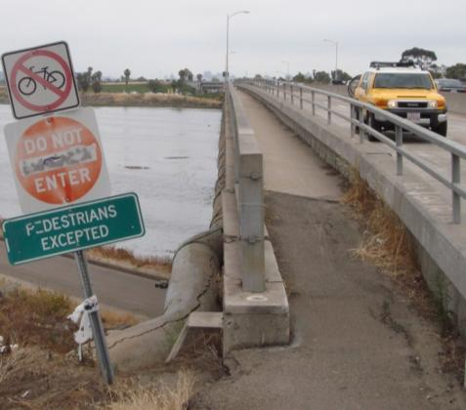
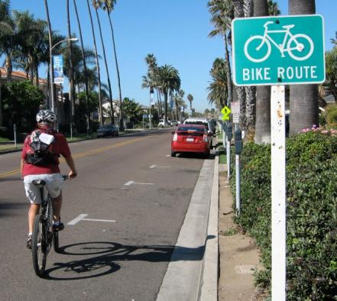
Functional Gaps

Slide 6
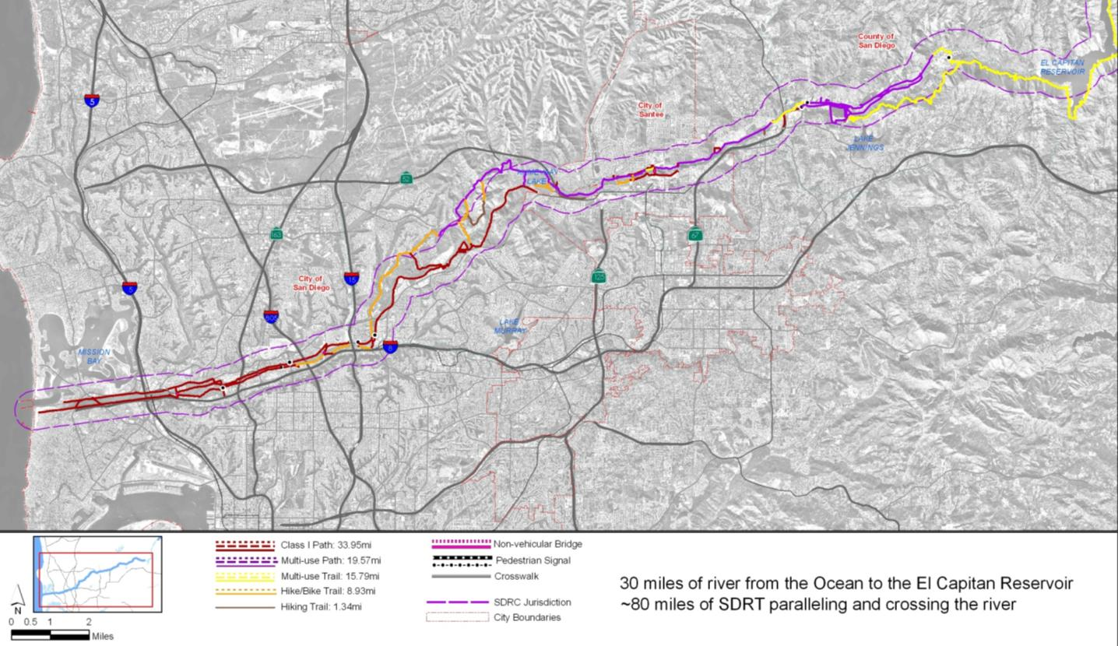
Proposed Trail Facilities

Slide 7
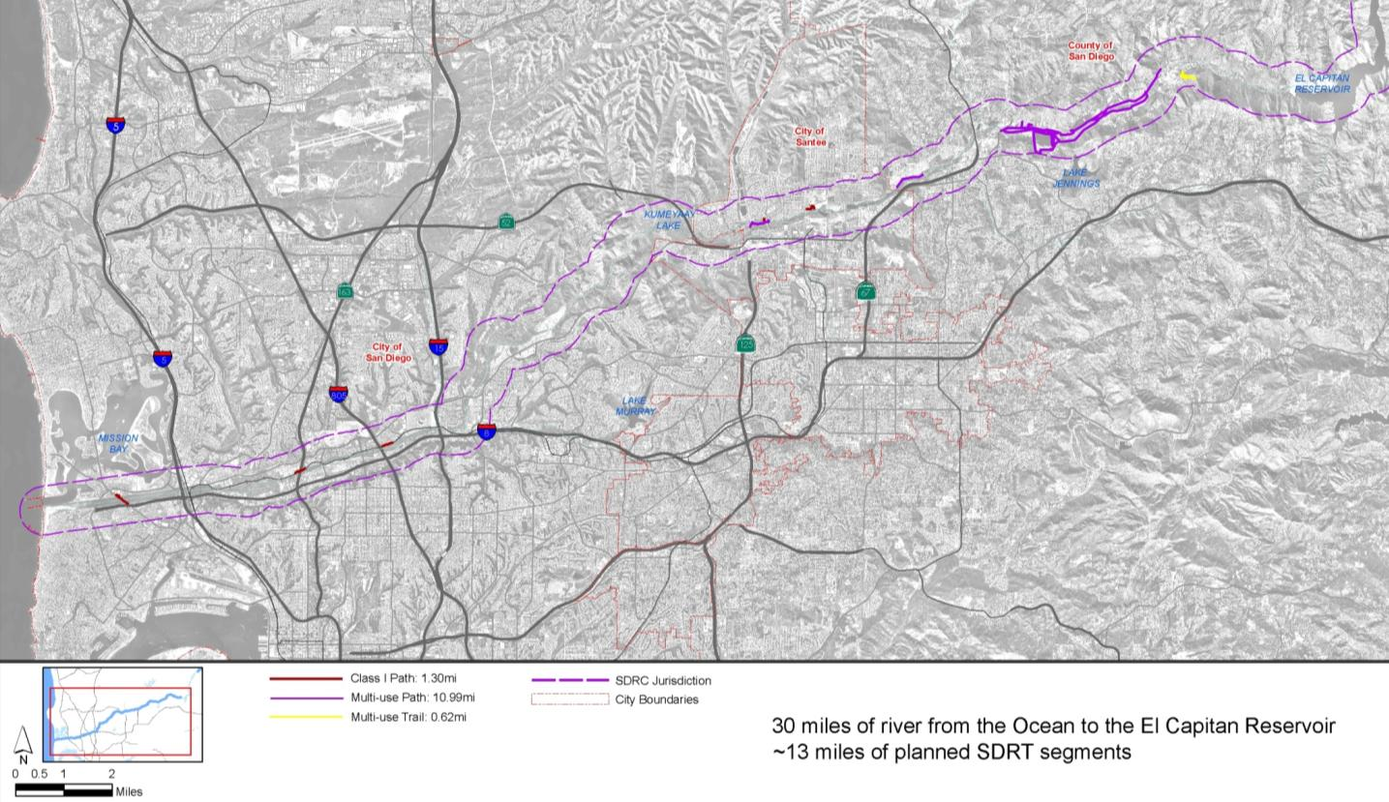
Planned Trail Facilities

Slide 8
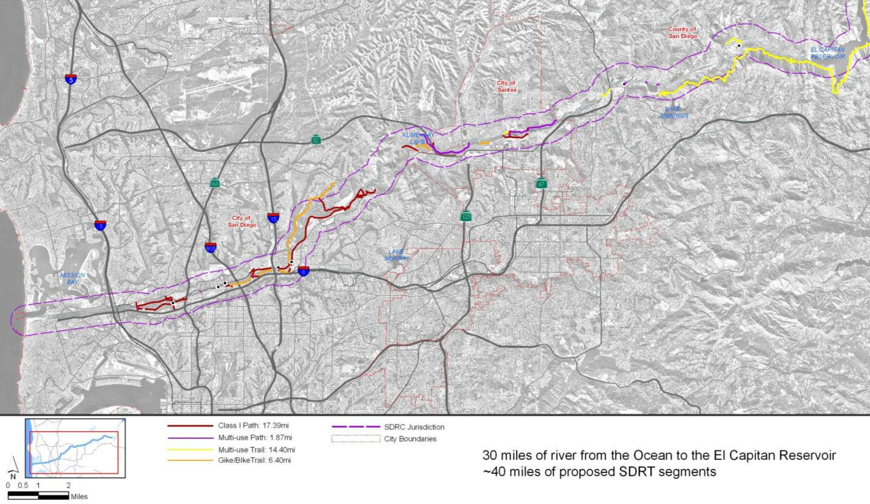
Proposed Trail Facilities

Slide 9
Next Steps
Distribute DRAFT Gaps Analysis to IWG members for review and comment
Incorporate IWG comments
Hold workshop with IWG members to develop initial prioritization of planned/proposed SDRT segments
Finalize Gaps Analysis

